Slide 1
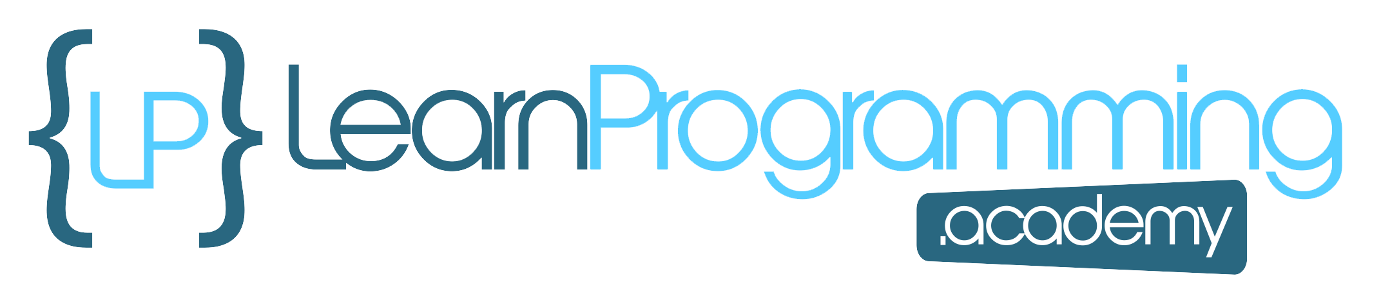
Other Techniques for Database Interactions
The alternative is something called the Java Persistence API, or JPA for short.
COMPLETE JAVA MASTERCLASS
Introduction to JPA and ORM

Slide 2
What is JPA?
JPA is a specification.
There's no default implementation of the specification, provided in Java's Standard Edition.
That being said, I still want to cover the topic briefly.
There's a very good chance, you'll be working on an application that uses some form of it.
Some popular implementations are Hibernate, Spring JPA, and EclipseLink, to name a few.
These are called JPA Providers.
In 2019, the Java Persistence API officially changed its name, to Jakarta Persistence API.
https://jakarta.ee/specifications/persistence/3.1/apidocs/jakarta.persistence/module-summary.html
COMPLETE JAVA MASTERCLASS
Introduction to JPA and ORM

Slide 3
What are some key concepts of JPA?
A few of the key concepts of the JPA specification include
Object-Relational Mapping, or ORM.
The Entity (which is the mapped object), and the Entity Manager which manages lifecycles of these entities.
The Persistence Context is a special cached area where the entities exist.
You can think of JPA as an extra layer of functionality, between your application code, and the JDBC code you saw in the last lectures.
COMPLETE JAVA MASTERCLASS
Introduction to JPA and ORM

Slide 4
Object-Relational Mapping or ORM
Object-Relational Mapping is a method of mapping database tables defined by columns, to a class with correlated fields, and setters and getters.
A record in a table then becomes an instance of one of these classes.
ORM frameworks often automate the process of object relational mapping.
Simplify code, reducing the need to write boilerplate classes.
Simplify database operations, hiding the complexities of SQL queries, and handling database interactions for you.
Provide code portability across different database systems.
Encourage a more structured and organized approach, to data access.
COMPLETE JAVA MASTERCLASS
Introduction to JPA and ORM

Slide 5
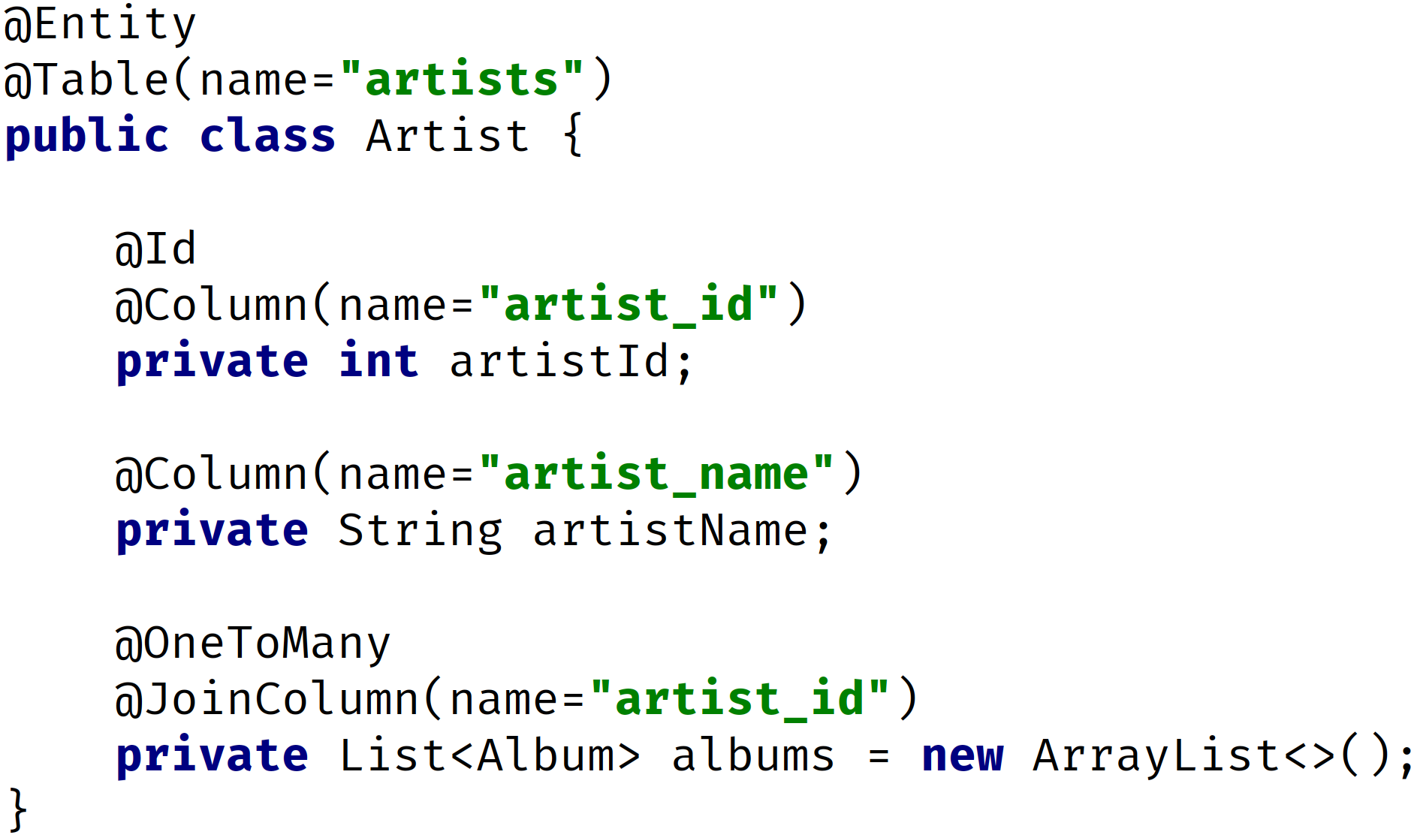
The Entity
Typically, an Entity is a class that represents a table in a relational database.
Each entity is annotated with metadata.
The example on this slide is a relatively simple one, of an annotated class, Artist.
COMPLETE JAVA MASTERCLASS
Introduction to JPA and ORM

Slide 6
The Entity Manager
The entity manager is implemented by the JPA Provider.
An entity can exist in a managed state, managed by the Entity Manager.
Or it can exist in a detached state, outside of an Entity Manager.
A detached entity can then be merged into an EntityManager, if a commit is needed to a persistence layer.
COMPLETE JAVA MASTERCLASS
Introduction to JPA and ORM

Slide 7
The Entity Manager
There are some key methods on the EntityManager interface to know, that line up with the CRUD operations
Operation | Method | Description
create | persist | Makes a detached instance managed and persistent.
read | find | This method searches for an entity of the specified class and primary key, and returns an instance that will be managed and persistent
update | merge | If an entity is managed, updates will be propagated automatically to the persistence layer, on a commit. If the entity is not yet managed, a merge method will make the entity managed and persist the changes.
delete | remove | Removes the entity instance from management, and executes a delete on the persistence layer if the instance is managed (not detached).
COMPLETE JAVA MASTERCLASS
Introduction to JPA and ORM

Slide 8
The Persistence Context
The persistence context has multiple purposes.
It tracks the lifecycle state of managed entities.
It synchronizes changes made to managed entities with the database.
It performs identity management, ensuring unique entity identity within a transaction.
It acts as a cache, reducing database roundtrips by keeping frequently accessed entities in memory, for faster retrieval.
COMPLETE JAVA MASTERCLASS
Introduction to JPA and ORM

